Slide 1
The instability of splitting algorithms in solving complex and non-linear equations
Siu A. Chin
Texas A&M University
Castellon, Sept. 6, 2010

Slide 2
Recent advances in splitting methods
Forward algorithms, with all positive time steps for solve time-irreversible equations with a diffusion kernel beyond the second-order.
Multi-product expansion for going beyond the fourth-order in solving time-irreversible equations with only a quadratic (rather than an exponential) growth in the number of operators.
Insights into the instability of splitting methods in solving multiple time scale and non-linear equations.

Slide 3
Exponential splittings
Sheng(89), Suzuki(91): Beyond second-order, you can’t have {t_{i} , v_{i} } >0!
Forward algorithms: include [V,[T,V]] in additional to T and V. Suzuki(96), Chin(97).
Fourth-order forward algorithms can now be derived for arbitrary number of operators analytically. Chin(06)
Even for classical dynamics, non-forward integrators evaluate the force very off the exact trajectory.

Slide 4
Fourth-order
algorithms in
solving the
Kepler orbit.
Solid squares
=Forest-Ruth
(90)
Plus sign
=MPE=RKN
Circles
= forward 4A
Chin(97)

Slide 5
Fourth-order
algorithms with six force- evaluations
Solid square: Blanes-Moan(02)
Circles:
forward A6
Chin(07)

Slide 6
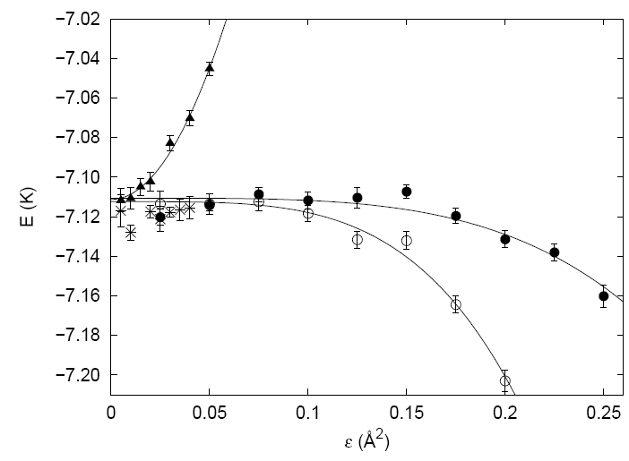
Fourth-order Diffuson Monte Carlo
Liquid
Helium
Forbert and
Chin (01)

Slide 7
Fourth-order algorithms for solving the imaginary time Gross-Pitaevskii equation
BEC in a rotating trap – vortices nucleation.
Chin and Krotscheck (05)

Slide 8
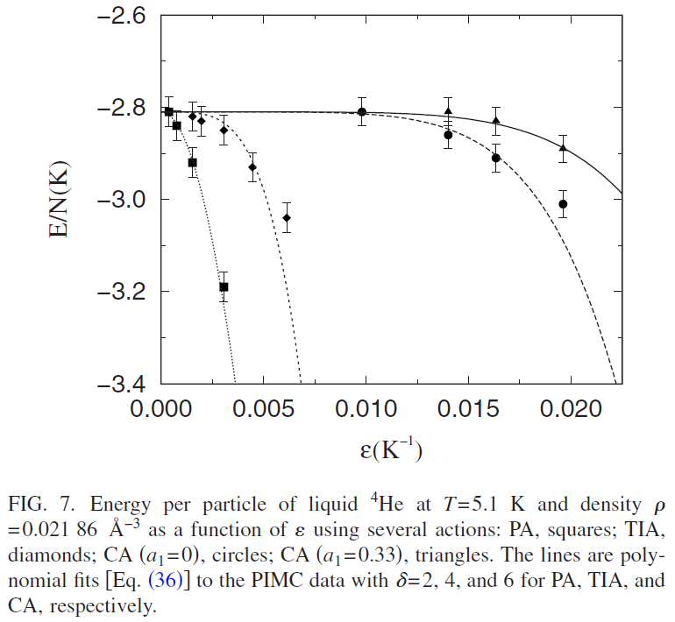
4th -6th order PIMC algorithms
Liquid Helium at finite temperature
Sakkos, Casulleras and Boronat(09)

Slide 9
Higher order algorithms
For a single product decomposition:
1)No general forward algorithms beyond the 4th order. Sixth-order forward algorithm must incorporate the operator H_{VTTTV}=[V,[T,[T,[T,V]]]] . Chin(05,07).
2)Higher order non-forward splitting algorithms require exponentially growing number of operators. Order 4, 6, 8, 10 requires 3, 7, 15 and 31 force-evaluations or FFT respectively.
3)A dead-end to high order algorithms ?

Slide 10
Multi-product expansion Chin(10), Blanes-Casas-Roe (99)
For any set of n integers {k₁, k₂, … k_{n}}, one can form
a 2n^{th} order expansion:
where (forward second-order)
and with exact expressions for the expansion
and error coefficients

Slide 11
Minimal expansion
For the harmonic sequence {k_{i}}={1,2,3,… n}, one has
The resulting algorithms are no longer symplectic, but
surprisingly, correspond to Nystrom integrators.
The number force-evaluations or FFT now only grow
as n(n+1)/2. Odd orders are also known.

Slide 12
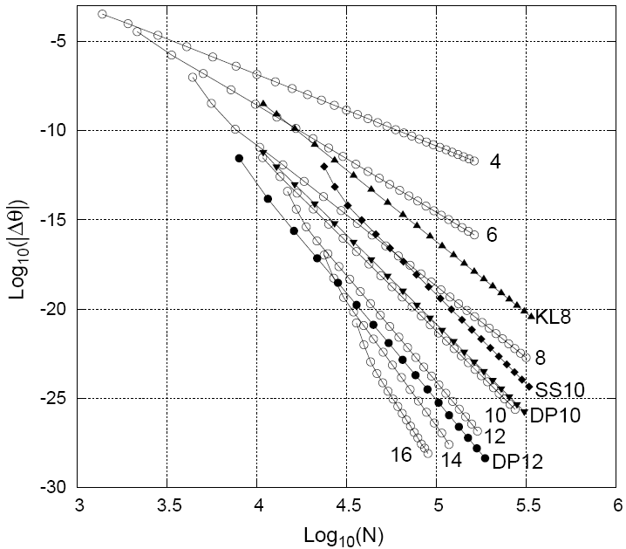
MPE for solving classical dynamics
The orbital
precession
error in the
Kepler problem.
Chin(2010)
DP12=Dormand
and Prince’s
12th – order
Integrator.

Slide 13
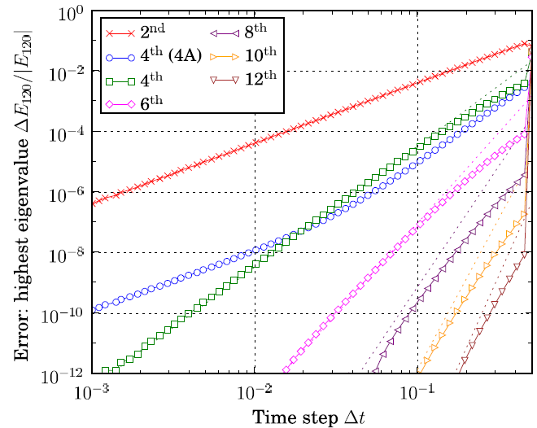
MPE for solving quantum states
Solving for the
120th state of a
model C60
molecule.
Chin, Janecek
and Krotscheck
(09)

Slide 14
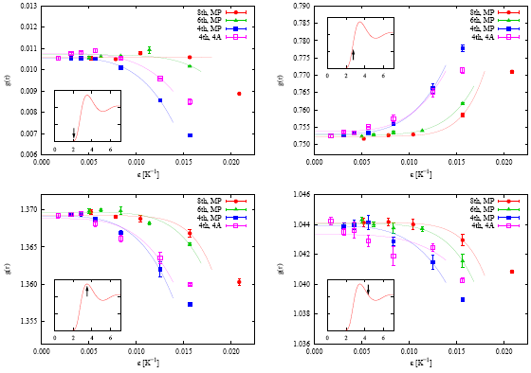
Higher Order PIMC results
Solving for the
static structure
factor of Liquid Helium
4th, 6th, and 8th orders
Zillich, Mayrhofer
and Chin
(2010)

Slide 15
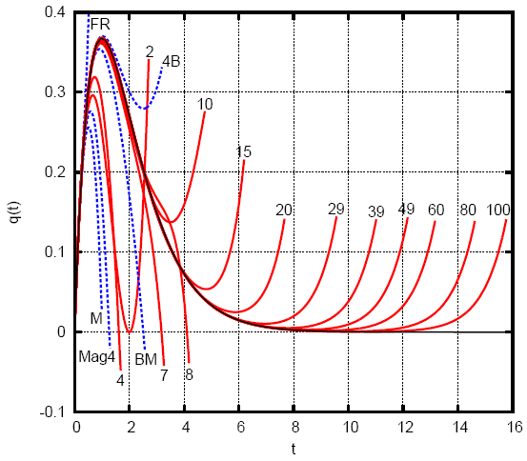
The hydrogen radial wave function as a time-dependent classical trajectory
Integrating out
from t=0.
The time-step
size is just t!
FR=Forest-Ruth
BM=Blanes-Moan
M=McLachlan
Mag4=Magnus
4B=forward B
MPE, up to
the 100th order!
Chin and Geiser (10)

Slide 16
Linear stability analysis (McLachan-Gray 94, Blanes-Casas-Murua 08)
For the harmonic oscillator
For time-symmetric algorithms
Stable when eigenvalues remained complex
and unstable when | | >1. Exact :
Algorithms:

Slide 17
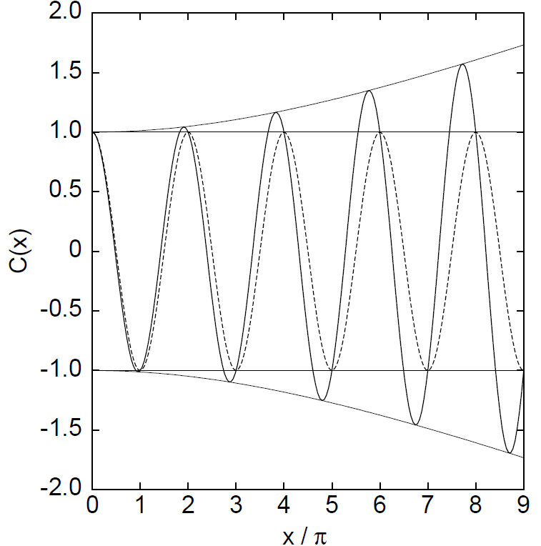
Multiple time stepping instability
Fast and slow forces:
Always unstable when
because the exact ( )
not expandable in

Slide 18
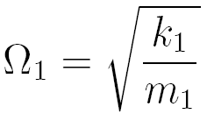
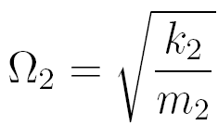
Restoring stability (Chin 04)
Alternative splitting:
with
then where
The stability polynomial ( , )
is now analytic in !
Lesson: must split spectrum analytically

Slide 19
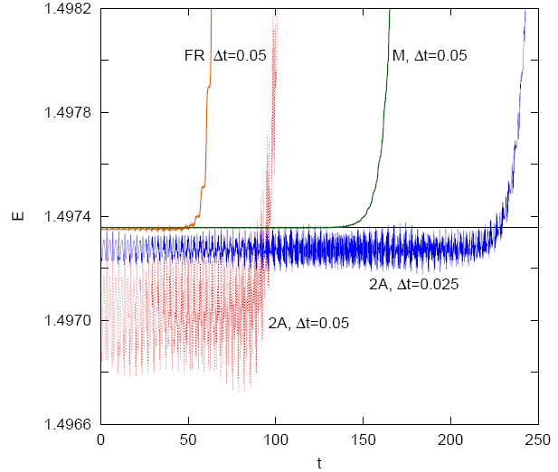
Instability of the nonlinear Schrodinger or Gross-Pitaevskii equation
Free propagation:
Nonlinear propagation:
Second-order alg. 2A

Slide 20
Side band analysis (Chin 07)
The propagation of a single Fourier component:
where . The growth of side band
errors with amplitude a and b
is governed by the Bogoliubov spectrum
and
is non-analytic in !

Slide 21
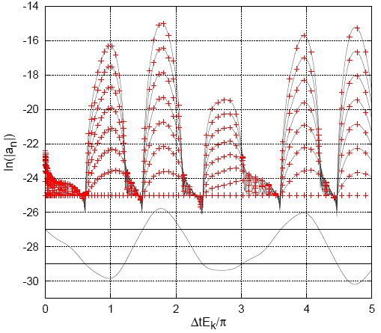
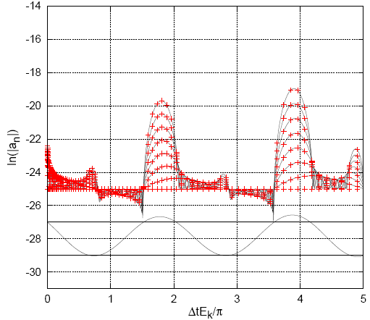
Algorithm dependent error growth
No fundamental cure at this time.
4th order Forest-Ruth 4th order McLachan

Slide 22
Conclusions
The study of forward algorithms have greatly advanced the state-of-art in solving time-irreversible equations. Plenty of applications ahead (diffusion-advection, etc.).
The multi-product expansion, while not symplectic/unitary, is an extremely simple method of achieving high-order accuracy and for solving time-irreversible equations.
Intransigent (not removed by going to higher order) instability results when the underlying spectrum is non-analytic in the splitting components. More clever splitting is necessary to restore stability.

